Slide 1
Predicting Mortgage Backed Securities Prepayment
Using Machine Learning Methods
ML group-21
Vinamr Kanodia (19ucs067)
Mohit Garg (19ucc027)
Nitish Khunteta(19ucs096)

Slide 2
Acknowledgement
We would like to express our special thanks of gratitude to our mentor Dr. Bharavi Mishra, for their able guidance and support throughout the project
Vinamr Kanodia 19ucs067
Mohit Garg 19ucc027
Nitish Khunteta 19ucs096

Slide 3
Table of Contents
Introduction
Datasets and features
Final Dataset
Methods
Evaluation
Conclusion

Slide 4
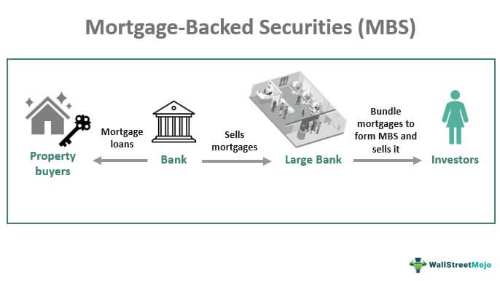
Introduction
Mortgage-backed securities, called MBS, are bonds secured by home and other real estate loans. They are created when a number of these loans, usually with similar characteristics, are pooled together. For instance, a bank offering home mortgages might round up $10 million worth of such mortgages.
So we have used the different types of machine learning algorithms such as Random forest and logistic regression and other 4 such algorithms to implement the dataset and point out the prepayment conditions and accuracy analyzing the dataset features.

Slide 5
DataSet and Features
In the prediction of mortgage prepayment we have used the freddie mac single family loan dataset and classified it into two different data mainly:
Origination data : Available at the start of dataset and hence static dataset
Performance data : Available at the monthly intervals and hence dynamic dataset.
This dataset contains 500137(500k) mortgage data with 26 features like CREDIT_SCORE, PREPAID , ORIGINAL_COMBINED_LOAN_TO_VALUE and many more features.
We will split the corresponding dataset into 3 parts for training , validation and testing
60% – Training dataset
20% – Validation dataset
20% — Testing dataset

Slide 6
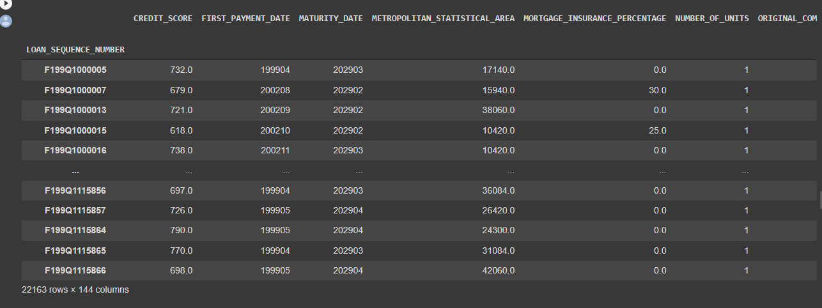
Our Final dataset after doing all manipulations

Slide 7
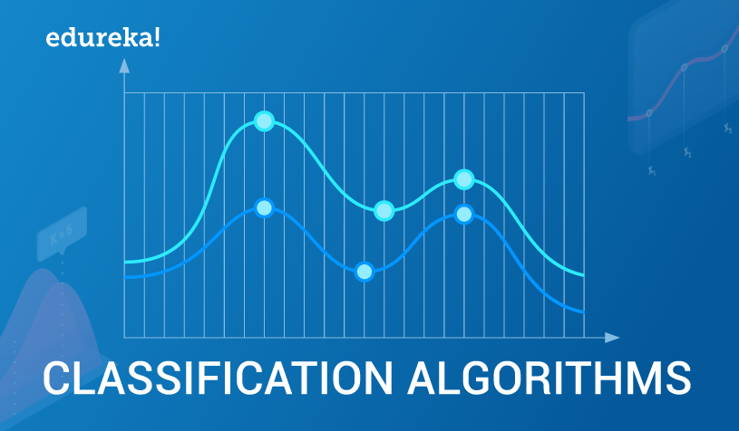
Methods
The methods we have applied to predict the prepayments is :
Logistic Regression(LR)
Support-Vector Machines(SVM)
Polynomial SVM
RBF SVM
Sigmoid SVM
Gaussian Discriminant Analysis(GDA)
Linear GDA
Feed-forward neural networks
Random forest(RF)

Slide 8

Evaluation
We have applied different ML techniques to our model to predict whether the individual will prepay or not. To find the accuracy of each model we made the confusion matrix for each methods we are using.
Where,
TP = True Positive
TN = True Negative
FP = False Positive
FN = False Negative

Slide 9
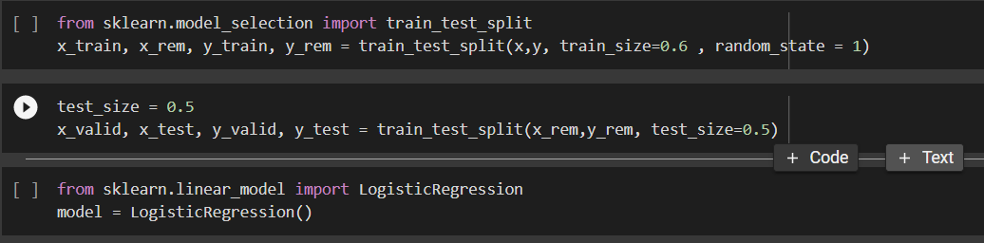
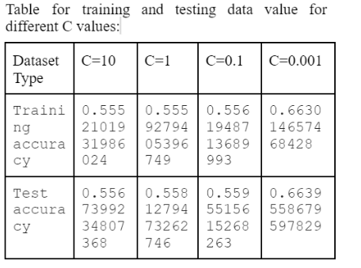
Logistic Regression
After splitting the data once we got the target dataset which is PREPAID we applied the LR and build the model
Then we apply L1 regularization

Slide 10
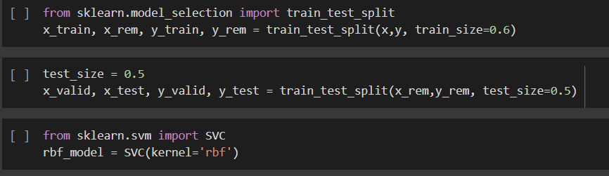
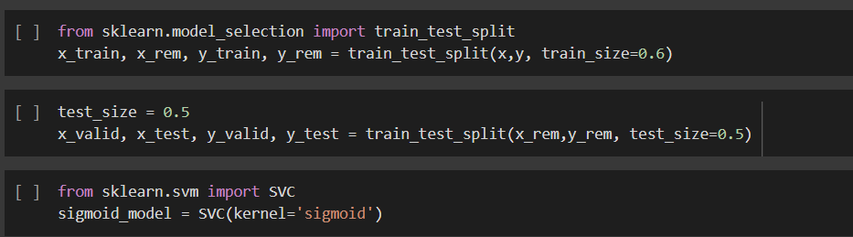
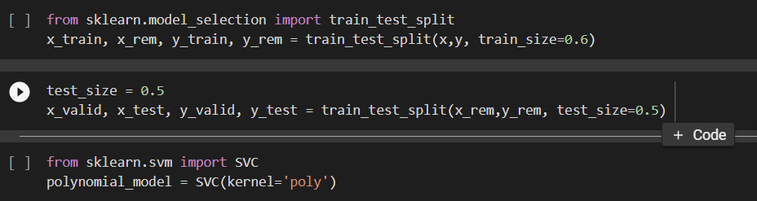
Support-Vector Machine
We have applied three kernels for training our SVM model(i.e. Rbf, sigmoid and poly) and we find each kernel give different accuracy.
Rbf - 96.140% sigmoid - 94.001% poly - 96.268%

Slide 11
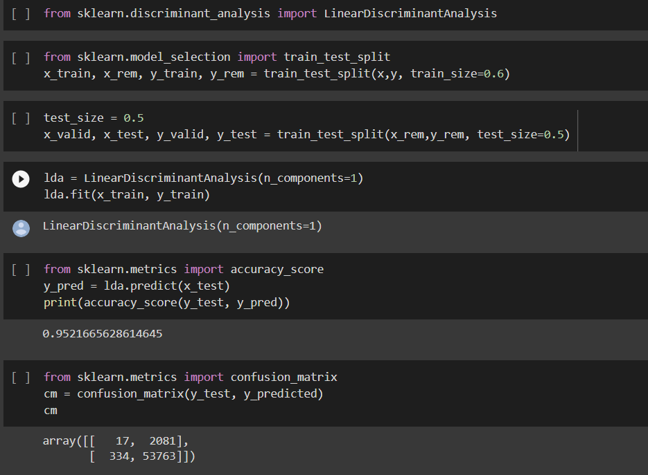
Gaussian Discriminant Analysis
LDA is used for the initial GDA and here covariance matrices per class is a very important part and LDA represents the same covariance matrix per class.
Accuracy of LDA - 95.216%

Slide 12
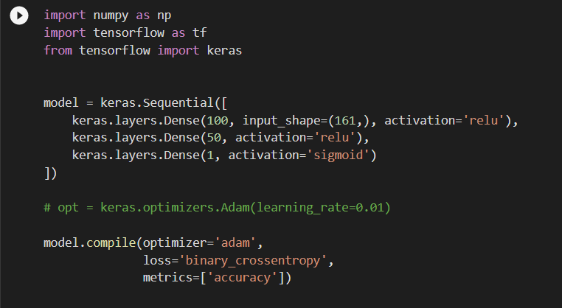
Neural network
Here we initiated by the sequential class this implies that the layer will be stacked on each other with the output of each other with the output of previous layer feeding into next. We then learn 100 , 50 , 1 weights in different layers.
Accuracy of NN model - 99.859%

Slide 13
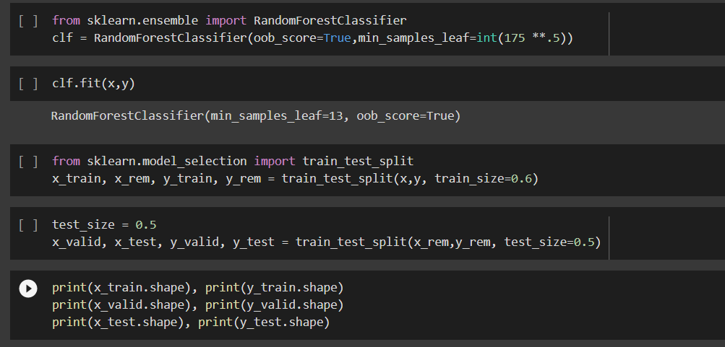
Random Forest
Here we uses the function of RandomForestClassifier for the basic data modeling using the train_validate_test_split and also uses the oob function which is basically same as validation but the only difference is it takes the value of left over data after implementation of model
Accuracy of RF - 96.440%

Slide 14
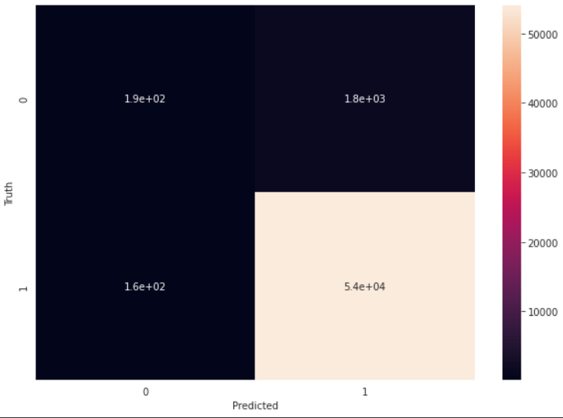
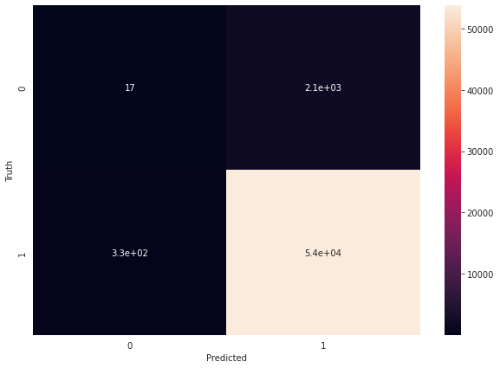
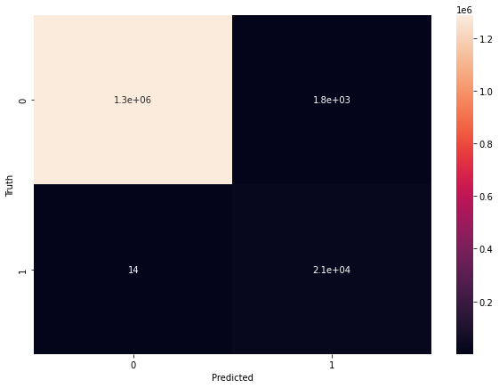
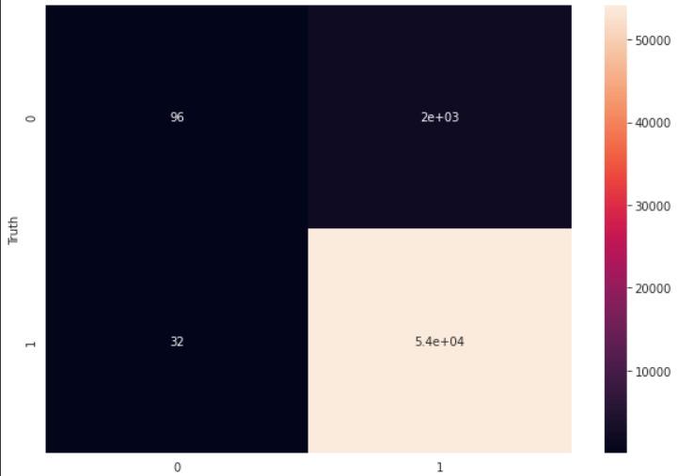
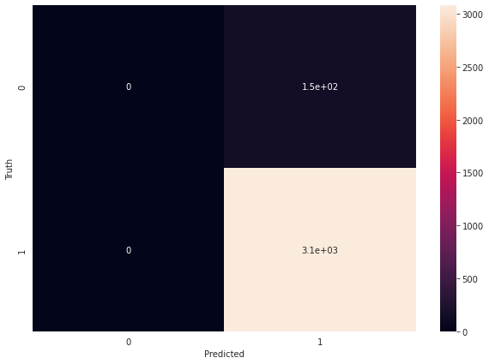
Logistic regression
Gaussian Discriminant Analysis
Neural Network
Random Forest
SVM

Slide 15
Conclusion
We use different techniques to train our model from which neural networks gives us the best result with accuracy of 99.89% where other models gives around 96% accuracy.
We can do more training and can apply more techniques with larger dataset but due to resources and time constraint we restricted our observations to these models only.

Slide 16
Thank you

